Slide 1
Data Science
Ganesh Selvaraj

Slide 2

What is Data Science

Slide 3
Steps in Data Science
Read Data
Data cleaning and preprocessing
Summarizing data
Data visualization
Building model
Fine tuning the model
Feature Engineering
Cross validation
Model deployment

Slide 4
Why Python?
Python libraries provide key features that are essential for data science
Pandas in python offers a variety of functions for data wrangling, manipulation and summary.
Matplotlib and seaborn offer visualization tools for condensing the statistical information and help In identifying trends and relationships.
Sci-kit learn library offers a range of algorithms for creating different ML models.

Slide 5
Why Python? (Advantages)
Provides a good collection of libraries that are robust and varied
Can be integrated with big data frameworks like Hadoop and Spark
Supports object oriented programming environment
Reasonably fast to prototype
Provides support for reading files from local databases and cloud.

Slide 6
Sources of data
Websites
Smartphone
Sensors from electronic devices(IoT)
E-commerce websites
Social networking websites

Slide 7
Python data types
Basic data types | Description | Values | Representation
Boolean | Represents the two values of logic | True or False | bool
integer | Positive and negative whole numbers | Set of all integers, Z | int
Complex | a+ib | Set of complex numbers | complex
Float | Real numbers | Floating point numbers | float
String | All string or characters enclosed between single or double quotes | Sequence of characters | str

Slide 8
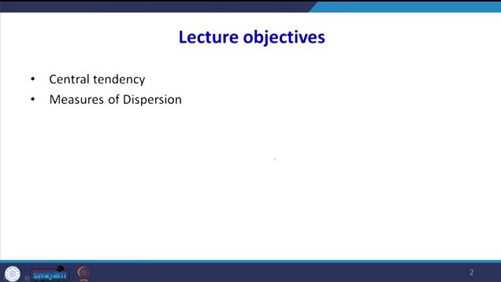
Statistics

Slide 9
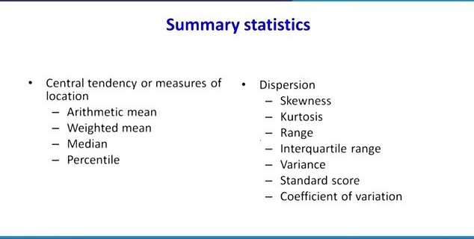

Slide 10
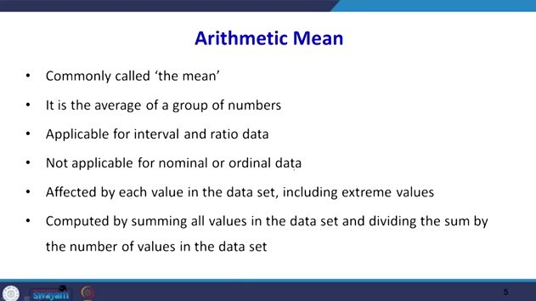

Slide 11
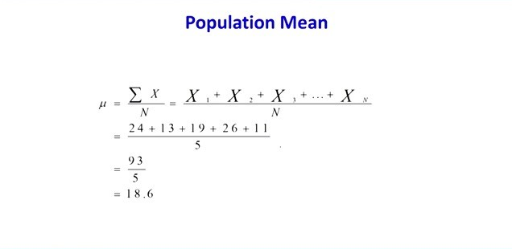

Slide 12
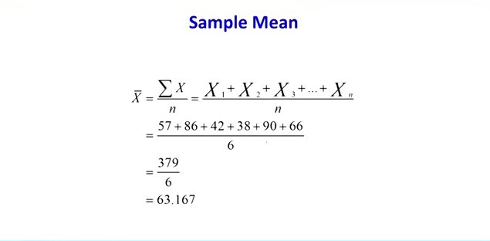

Slide 13
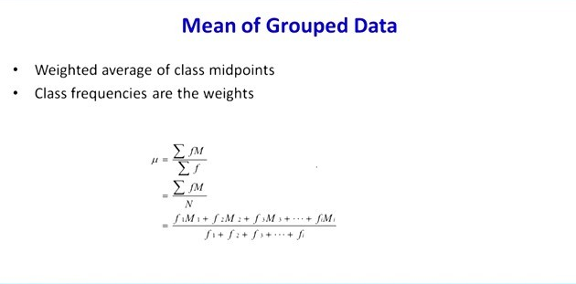

Slide 14
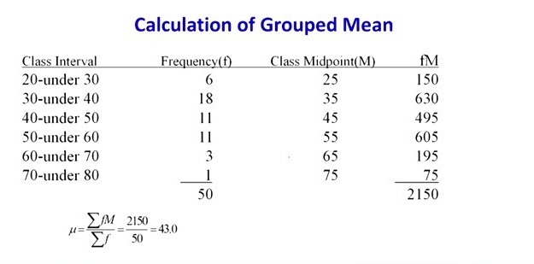

Slide 15
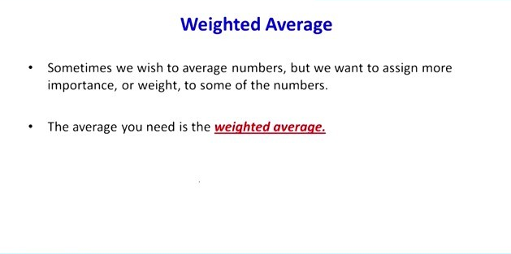

Slide 16
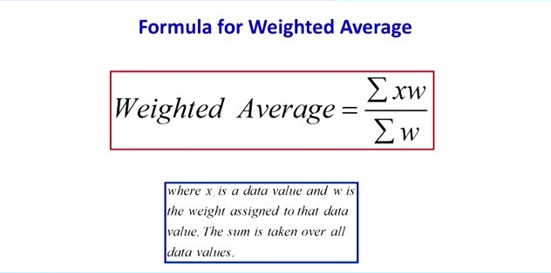

Slide 17
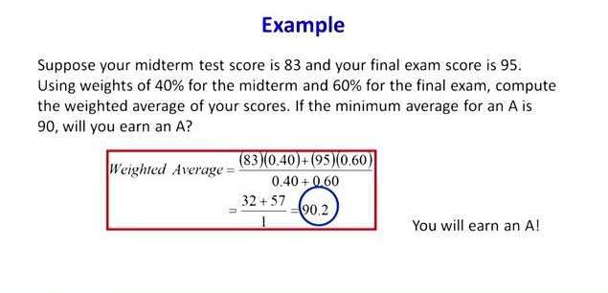

Slide 18
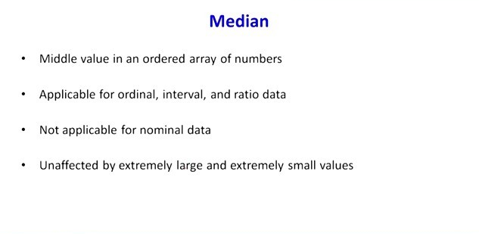

Slide 19
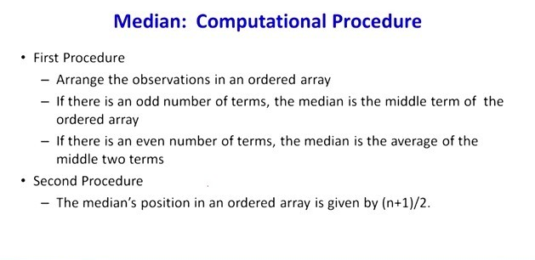

Slide 20
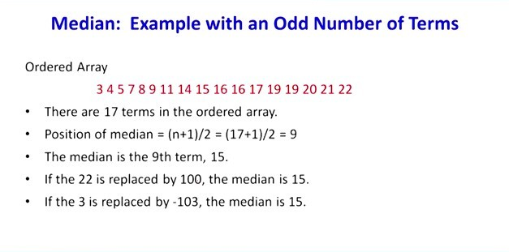

Slide 21
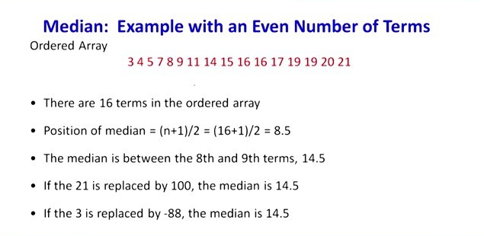

Slide 22
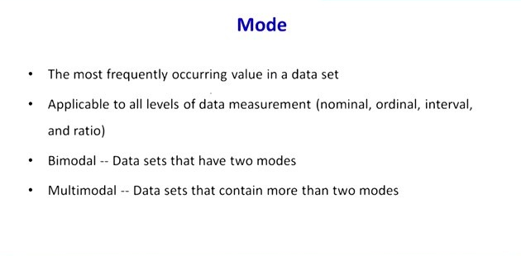

Slide 23
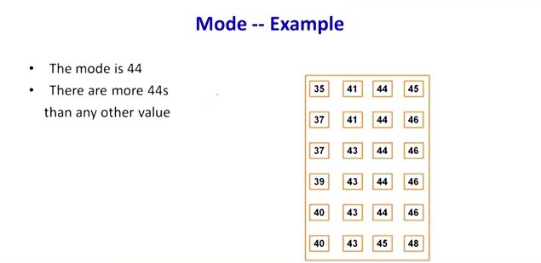

Slide 24
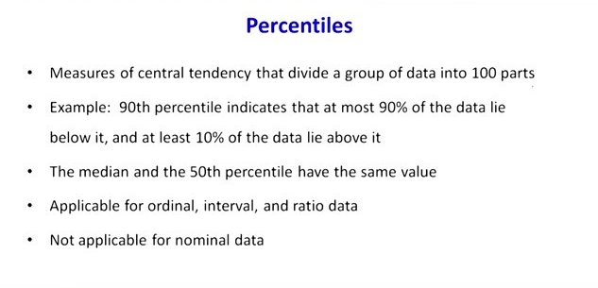

Slide 25
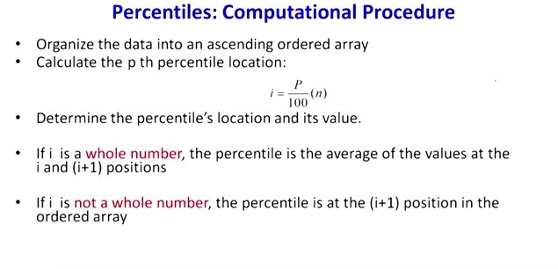

Slide 26
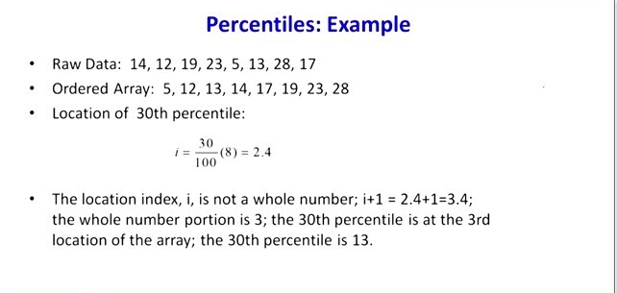

Slide 27
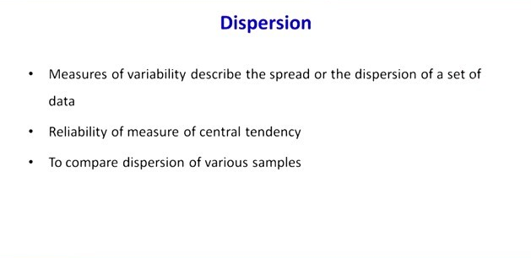

Slide 28
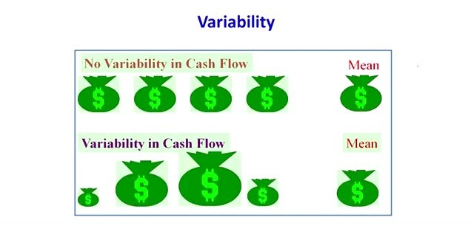

Slide 29
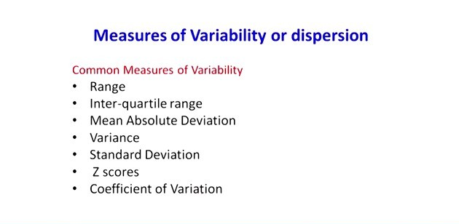

Slide 30
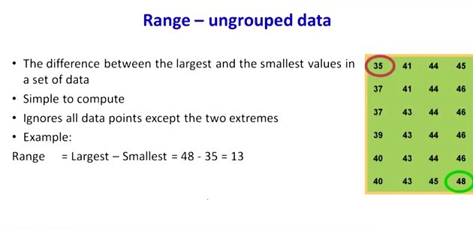

Slide 31
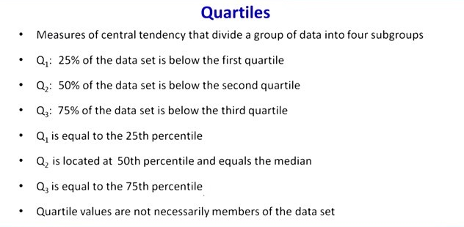

Slide 32
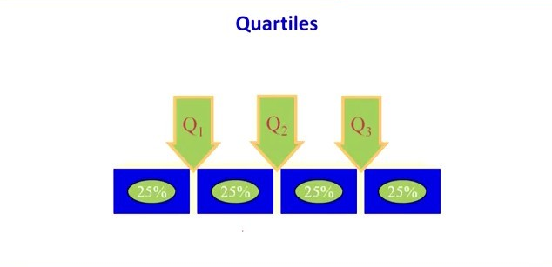

Slide 33
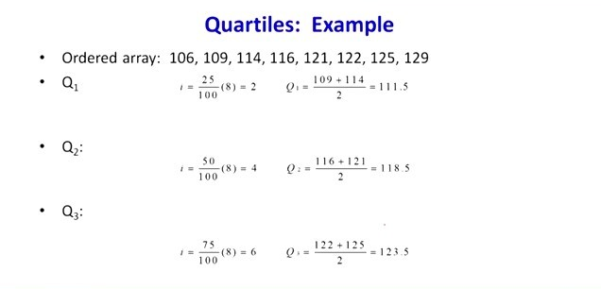

Slide 34
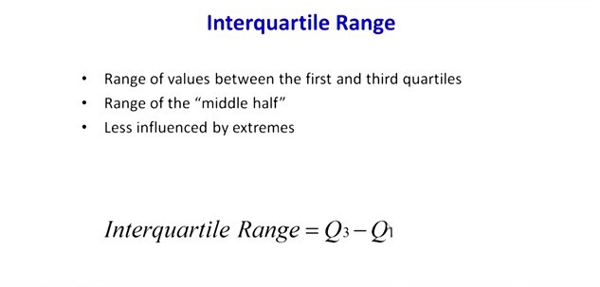

Slide 35
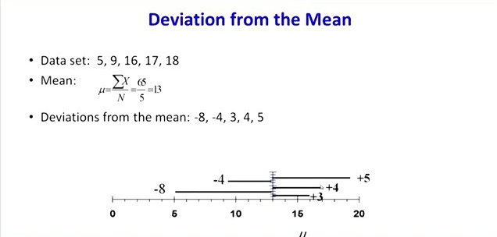

Slide 36
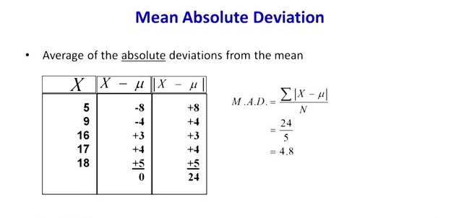

Slide 37
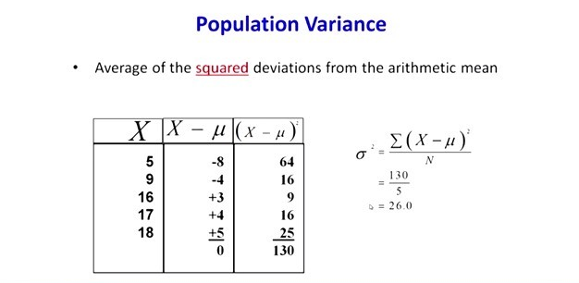

Slide 38
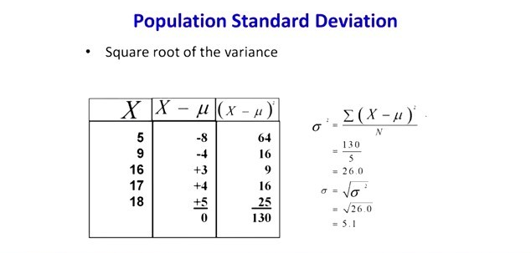

Slide 39
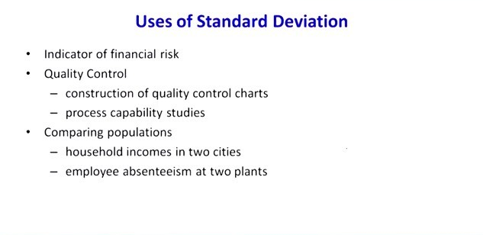

Slide 40
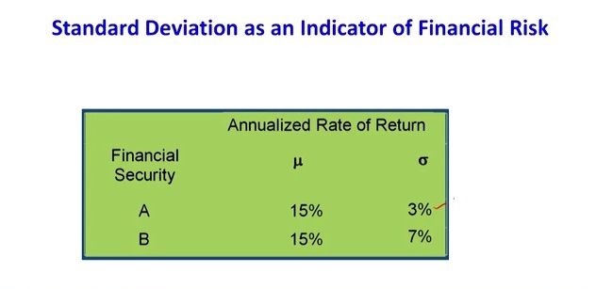

Slide 41
Hypothesis Testing
Hypothesis testing is a statistical method that is used in making statistical decisions using experimental data
A hypothesis test evaluates two mutually exclusive statements about a population to determine which statement is best supported by the sample data
Null hypothesis:
It is a basic assumption or made based on domain or problem knowledge
Alternative hypothesis :
used in hypothesis testing that is contrary to the null hypothesis.

Slide 42
Hypothesis Testing
Level of significance:
Refers to the degree of significance in which we accept or reject the null-hypothesis. 100% accuracy is not possible for accepting or rejecting a hypothesis, so we therefore select a level of significance that is usually 5%.
Type I error: When we reject the null hypothesis, although that hypothesis was true.
Type II errors: When we accept the null hypothesis but it is false. Type II errors are denoted by beta.

Slide 43
Hypothesis Testing
P-value :-
The P value, or calculated probability, is the probability of finding the observed, or more extreme, results when the null hypothesis (H 0) of a study question is true.

Slide 44
Widely used hypothesis testing type
T Test ( Student T test)
Z Test
ANOVA Test
Chi-Square Test

Slide 45
T- Test
T- Test :- A t-test is a type of inferential statistic which is used to determine if there is a significant difference between the means of two groups which may be related in certain features.
It is mostly used when the data sets, would follow a normal distribution and may have unknown variances.
T-test has 2 types : 1. one sampled t-test 2. two-sampled t-test.

Slide 46
Paired sampled t-test
Paired sampled t-test :- The paired sample t-test is also called dependent sample t-test. It’s an uni variate test that tests for a significant difference between 2 related variables.
An example of this is if you where to collect the blood pressure for an individual before and after some treatment, condition, or time point.
H0 :- means difference between two sample is 0
H1:- mean difference between two sample is not 0

Slide 47
Z Test
Your sample size is greater than 30. Otherwise, use a t test.
Data points should be independent from each other. In other words, one data point isn’t related or doesn’t affect another data point.
Your data should be normally distributed. However, for large sample sizes (over 30) this doesn’t always matter.
Your data should be randomly selected from a population, where each item has an equal chance of being selected.
Sample sizes should be equal if at all possible.

Slide 48
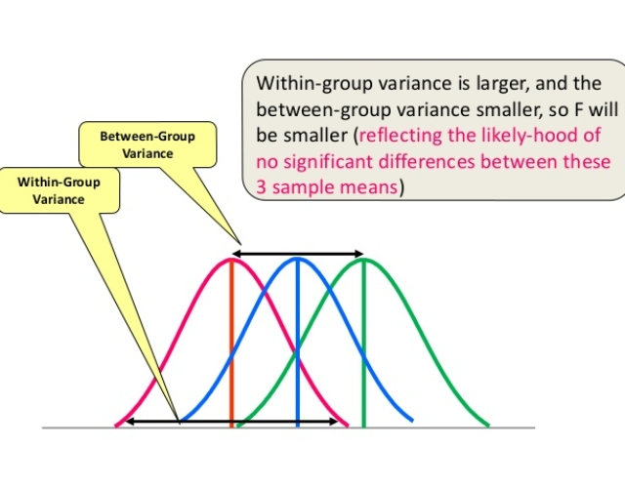
ANOVA (F-TEST)

Slide 49
One Way F-test(Anova) :- It tell whether two or more groups are similar or not based on their mean similarity and f-score.

Slide 50
Chi-Square Test
The test is applied when you have two categorical variables from a single population.
It is used to determine whether there is a significant association between the two variables.
For example, in an election survey, voters might be classified by gender (male or female) and voting preference. We could use a chi-square test for independence to determine whether gender is related to voting preference

Slide 51
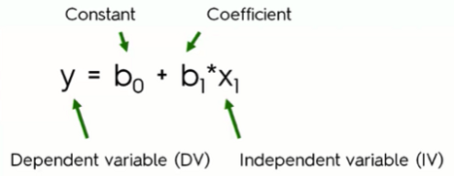
Linear Regression
Linear regression is a linear approximation of a causal relationship between two or more variables.
y = f ( x₁, x₂, .… xₙ )
Types of Regression
Simple Linear Regression

Slide 52
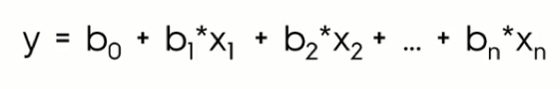
Multiple linear regression

Slide 53
Simple Linear Regression
The dependent variable (DV): As you probably already guessed from the name, the DV is a variable that you try to understand in terms of its dependence on another variable.
The independent variable (IV): The IV is the variable that affects the dependent variable. the studying hours are the independent variables in their respective cases.

Slide 54
Simple Linear Regression
The coefficient: The independent variable’s coefficient basically determines how a one-unit change in the IV can affect the DV.
The constant (b₀): The point where the straight (regression) line intersects with the Y-axis.

Slide 55
Multiple linear regression
y - dependent variable
x₁, x₂, .… xₙ - independent variables
b₀ - intercept, the value of y when independent variables are zero
b₁, b₂, .… bₙ - regression coefficient of independent variables

Slide 56
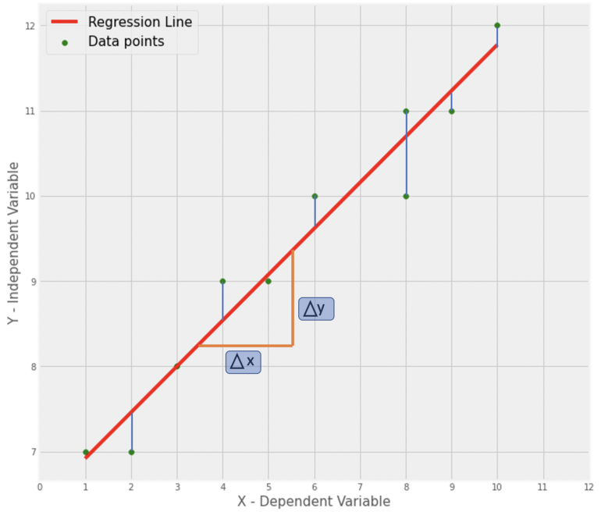
Slope of a line in a graph
Δ𝑦 = 4.66
Δ𝑥 = 8.64
c (Intercept) = 6.38, where the line intersects with the y-axis
m (Slope) = 0.54

Slide 57
Linear Regression- Loss Function
The loss is the error in our predicted value of m and c.
Our goal is to minimize this error to obtain the most accurate value of m and c. We will use the Mean Squared Error function to calculate the loss.
There are three steps in this function:
Find the difference between the actual y and predicted y value(y = mx + c), for a given x.
Square this difference.
Find the mean of the squares for every value in X.

Slide 58
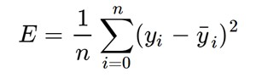
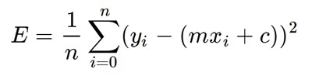

Slide 59
The Gradient Descent Algorithm
Gradient descent is an iterative optimization algorithm to find the minimum of a function. Here that function is our Loss Function.

Slide 60
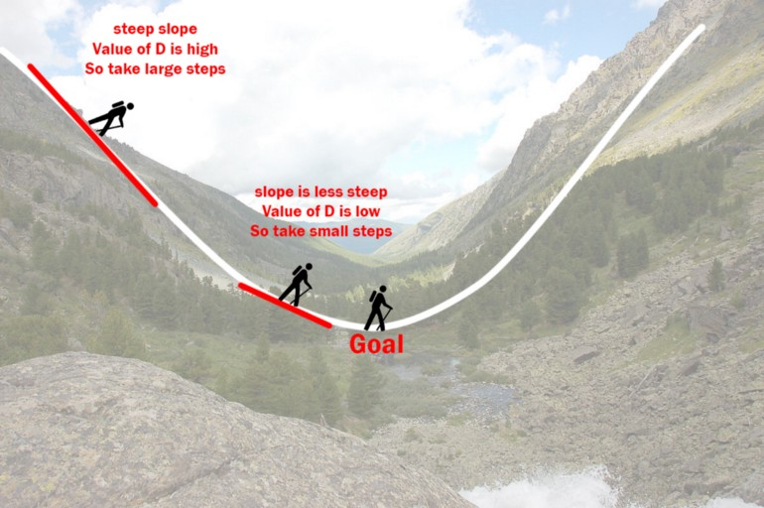
Understanding Gradient Descent

Slide 61
Gradient Descent
Let’s try applying gradient descent to m and c and approach it step by step:
Initially let m = 0 and c = 0. Let L be our learning rate. This controls how much the value of m changes with each step. L could be a small value like 0.0001 for good accuracy.
Calculate the partial derivative of the loss function with respect to m, and plug in the current values of x, y, m and c in it to obtain the derivative value D.

Slide 62
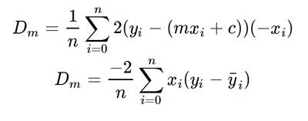
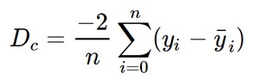
Gradient Descent
Dₘ is the value of the partial derivative with respect to m.
find the partial derivative with respect to c, Dc :

Slide 63
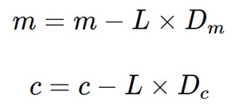
Gradient Descent
Now we update the current value of m and c using the following equation:
We repeat this process until our loss function is a very small value or ideally 0 (which means 0 error or 100% accuracy). The value of m and c that we are left with now will be the optimum values.

Slide 64
Gradient Descent
m can be considered the current position of the person. D is equivalent to the steepness of the slope and L can be the speed with which he moves.
Now the new value of m that we calculate using the above equation will be his next position, and L×D will be the size of the steps he will take.
When the slope is more steep (D is more) he takes longer steps and when it is less steep (D is less), he takes smaller steps.
Finally he arrives at the bottom of the valley which corresponds to our loss = 0.

Slide 65
Model Building Example
…

Slide 66
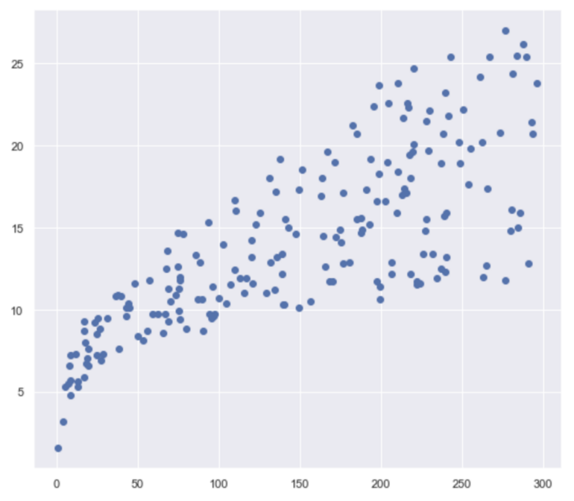
Assumptions for Linear Regression
Linearity
There is a linear relationship between the dependent variable (y) and the independent variable (x).
We can check for linearity by creating a scatter plot.

Slide 67
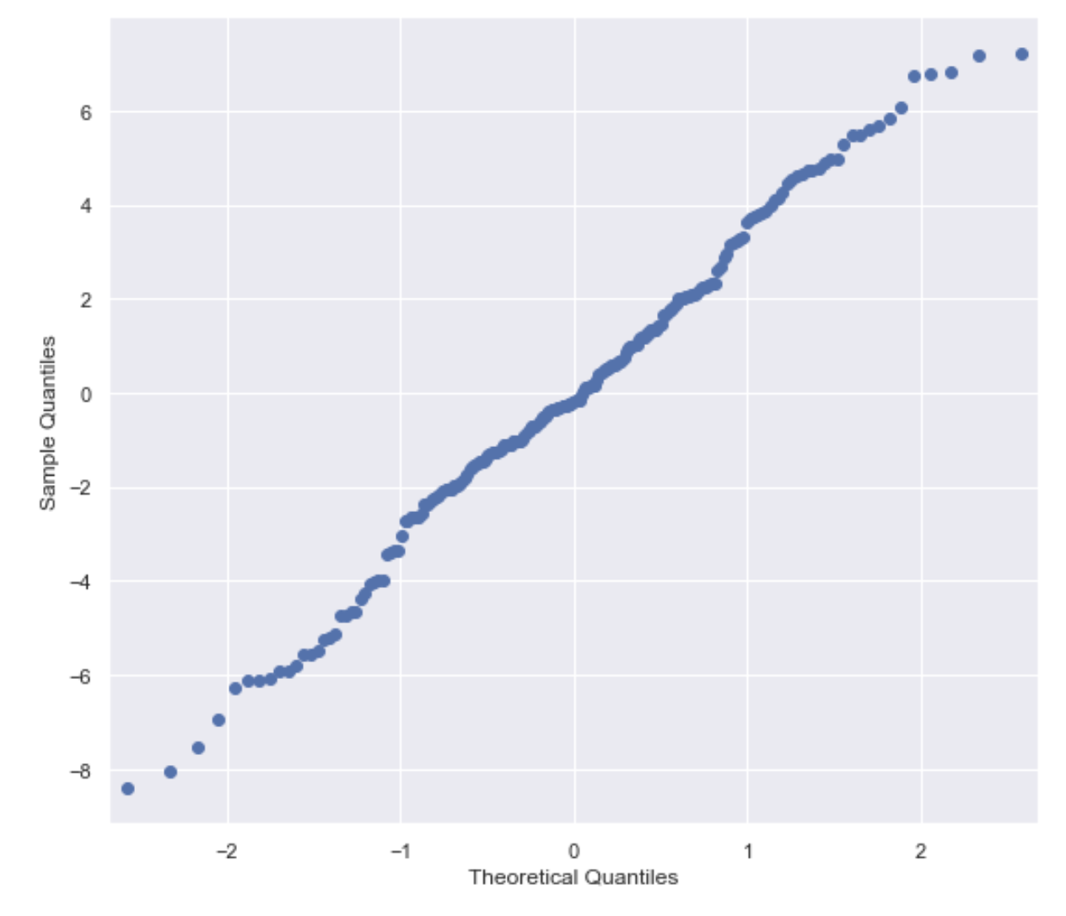
Assumptions for Linear Regression
This assumption states that the residuals (difference between actual_y and predicted_y) of a model are normally distributed.
This assumption can be checked by created histograms or Q-Q-Plots.
Q-Q-Plots (quantile-quantile-plots) are scatterplots of two sets of quantiles plotted against each other.

Slide 68
Assumptions for Linear Regression
Little/No Multicollinearity (Multiple Linear Regression)
Multicollinearity describes the correlation between the predictor variables.
This assumption states that the predictor variables are independent.
We can check this assumption by creating pair plots and/or heat maps.
Another method would be to calculate the Variance Inflation Factor (VIF).

Slide 69
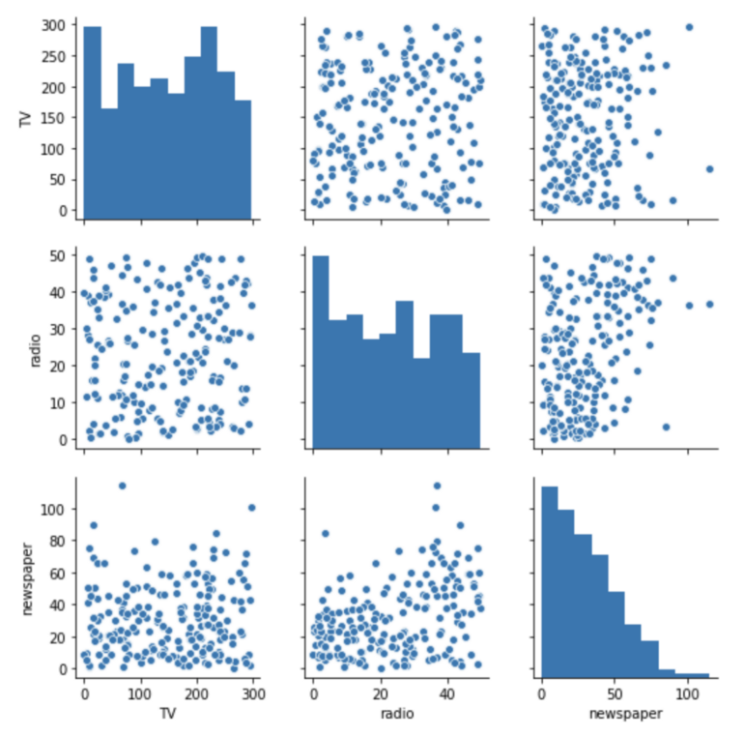
Assumptions for Linear Regression
#Pairplot sns.pairplot(sales, vars = ['TV', 'radio', 'newspaper’]);

Slide 70
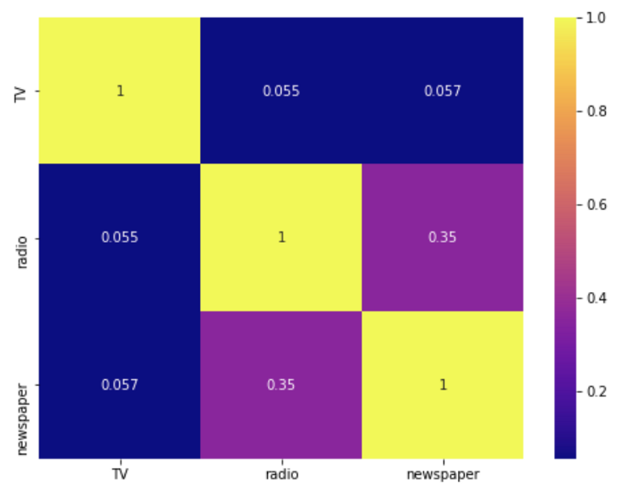
Assumptions for Linear Regression
#Heatmap (correlation matrix) sns.heatmap(sales.drop('sales', axis=1).corr(), annot=True, cmap='plasma’);

Slide 71
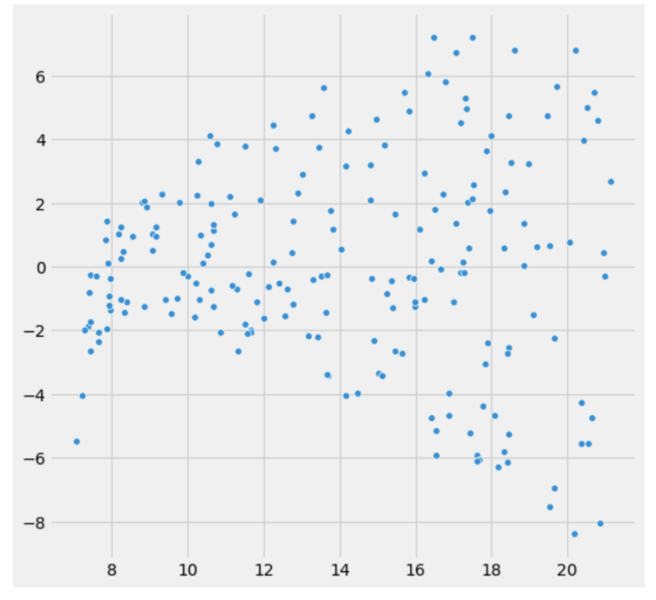
Assumptions for Linear Regression Homoscedasticity
Homoscedasticity refers to the variability of the dependent variable being equal across the independent variable values.
We can check this assumption by creating a scatterplot of the model predictions and residuals, we’re looking for the residuals to equal across the regression line.
We could also use a significance test such as the Breusch-Pagan test.

Slide 72
Little/No Autocorrelation in Residuals
Autocorrelation refers to the model residuals not being independent. If there were to be a correlation in the error terms, our model’s accuracy would decrease. This assumption can be checked using the Durbin-Watson test or creating an error plot.
2: No Autocorrelation
0–1.9: Positive Autocorrelation
2.1–4: Negative Autocorrelation
#Durbin-Watson test in OLS summaryfsm.summary()

Slide 73
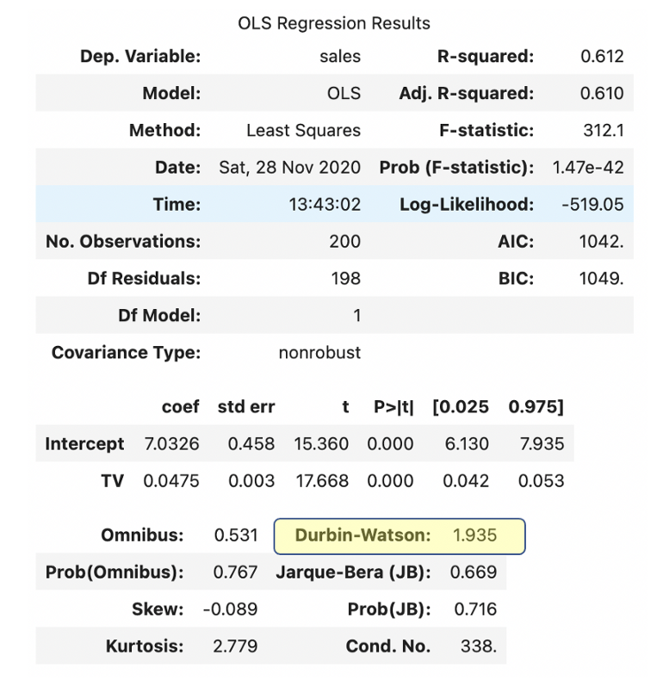
OLS model Summary

Slide 74

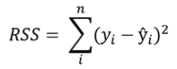


Linear Regression
Where TSS (Total sum of squares) and RSS (Residual sum of squares)

Slide 75


Logistic Regression

Slide 76
Logistic Regression
Logistic Function (Sigmoid Function):
The sigmoid function is a mathematical function used to map the predicted values to probabilities.
It maps any real value into another value within a range of 0 and 1.
The value of the logistic regression must be between 0 and 1, which cannot go beyond this limit, so it forms a curve like the "S" form. The S-form curve is called the Sigmoid function or the logistic function.
In logistic regression, we use the concept of the threshold value, which defines the probability of either 0 or 1. Such as values above the threshold value tends to 1, and a value below the threshold values tends to 0.

Slide 77
Logistic Regression
Decision Boundary
To predict which class a data belongs, a threshold can be set. Based upon this threshold, the obtained estimated probability is classified into classes.
Say, if predicted_value ≥ 0.5, then classify email as spam else as not spam.
Decision boundary can be linear or non-linear. Polynomial order can be increased to get complex decision boundary.

Slide 78


Binary cross-entropy loss (aka log loss):
Simplified cost function

Slide 79


Log of Odds

Slide 80

Confusion Matrix

Slide 81
Confusion Matrix
True Positive (TP) : Model predicted positive and Actual was positive too. Yayy ! Correct Prediction.
False Positive (FP) : Model predicted positive but actual was negative (Incorrect Prediction). Oops ! Type 1 error .
False Negative (FN) : Model predicted Negative but actual was positive (Incorrect Prediction). Type 2 error Now !!
True Negative(TN) : Model predicted Negative and actual was also Negative. Yayy ! Correct prediction.

Slide 82

Confusion Matrix
Recall or True Positive Rate (TPR) : It indicates out of all the True Positive observed values ,how many are predicted correctly(Positive) by the model and given by ratio of True Positive Predicted (TP)/ Total Positive observed (P), Where, P= TP + FN.

Slide 83

Confusion Matrix
Miss Rate / False Negative Rate (FNR) : It indicates out of all the True Positive observed values ,how many are predicted incorrectly(Negative) by the model and given by ratio of False Negative Predicted (FN)/ Total Positive observed (P), Where, P= TP + FN.

Slide 84

Confusion Matrix
Fall Out /False Positive Rate (FPR): It indicates out of all the Negative observed valued, how many are predicted incorrectly (Positive) by the model. It is given by ratio of False Positive Predicted (FP)/ Total Negative observed (N), Where N= FP+TN.

Slide 85

Confusion Matrix
Selectivity or True Negative Rate (TNR) : It indicates out of all the Negative observed valued, how many are actually predicted correctly (Negative) by the model. It is given by ratio of True Negative Predicted (TN)/ Total Negative observed (N), Where N= FP+TN.

Slide 86

Confusion Matrix
Precision / Positive Prediction Value (PPV) : It is ratio of actual Positive observed (TP) to Total Positive Predicted .

Slide 87

Confusion Matrix
F-1 Score is harmonic mean of Precision and recall and gives same weightage to both precision and recall, given by :

Slide 88

Confusion Matrix

Slide 89
ROC Curve
What is AUC-ROC curve? AUC (Area Under The Curve) ROC (Receiver Operating Characteristics) curve, also known as AUROC (Area Under the Receiver Operating Characteristics) is a performance measurement for classification problems at various threshold levels.
ROC is a probability curve that plots the TPR (True Positive Rate) against FPR (False Positive Rate).

Slide 90

ROC Curve

Slide 91

ROC Curve

Slide 92

ROC Curve

Slide 93

K Nearest neighbour - KNN

Slide 94

KNN classifier

Slide 95
KNN
How does K-NN work?
The K-NN working can be explained on the basis of the below algorithm:
Step-1: Select the number K of the neighbors
Step-2: Calculate the Euclidean distance of K number of neighbors
Step-3: Take the K nearest neighbors as per the calculated Euclidean distance.
Step-4: Among these k neighbors, count the number of the data points in each category.
Step-5: Assign the new data points to that category for which the number of the neighbor is maximum.
Step-6: Our model is ready.

Slide 96


Slide 97


Slide 98
KNN
Advantages of KNN Algorithm:
It is simple to implement.
It is robust to the noisy training data
It can be more effective if the training data is large.
Disadvantages of KNN Algorithm:
Always needs to determine the value of K which may be complex some time.
The computation cost is high because of calculating the distance between the data points for all the training samples.

Slide 99

Support Vector Machine

Slide 100

SVM

Slide 101

SVM
According to the SVM algorithm we find the points closest to the line from both the classes.These points are called support vectors.

Slide 102
TUNING PARAMETERS
Parameters are arguments that you pass when you create your classifier. Following are the important parameters for SVM-
1]C:
It controls the trade off between smooth decision boundary and classifying training points correctly. A large value of c means you will get more training points correctly.

Slide 103


Slide 104
SVM
Gamma:
It defines how far the influence of a single training example reaches. If it has a low value it means that every point has a far reach and conversely high value of gamma means that every point has close reach.
If gamma has a very high value, then the decision boundary is just going to be dependent upon the points that are very close to the line.
This is because the closer points get more weight
If the gamma value is low even the far away points get considerable weight and we get a more linear curve.

Slide 105

Naïve Bayes Classifier
It describes the probability of an event, based on prior knowledge of conditions that might be related to the event.

Slide 106
Bayes theorem Example
Assume that the word ‘offer’ occurs in 80% of the spam messages in my account. Also, let’s assume ‘offer’ occurs in 10% of my desired e-mails. If 30% of the received e-mails are considered as a scam, and I will receive a new message which contains ‘offer’, what is the probability that it is spam?

Slide 107
Nayes Theorem
Now, I assume that I received 100 e-mails. The percentage of spam in the whole e-mail is 30%. So, I have 30 spam e-mails and 70 desired e-mails in 100 e-mails. The percentage of the word ‘offer’ that occurs in spam e-mails is 80%. It means 80% of 30 e-mail and it makes 24. Now, I know that 30 e-mails of 100 are spam and 24 of them contain ‘offer’ where 6 of them not contains ‘offer’.
The percentage of the word ‘offer’ that occurs in the desired e-mails is 10%. It means 7 of them (10% of 70 desired e-mails) contain the word ‘offer’ and 63 of them not.

Slide 108

Bayes Theorem

Slide 109

Bayes Theorem
P( contains offer|spam) = 0.8 (given in the question)
P(spam) = 0.3 (given in the question)Now we will find the probability of e-mail with the word ‘offer’. We can compute that by adding ‘offer’ in spam and desired e-mails. Such that;
P(contains offer) = 0.3*0.8 + 0.7*0.1 = 0.31

Slide 110

Bayes Theorem

Slide 111
Unsupervised Learning Kmeans Clustering
Kmeans algorithm is an iterative algorithm that tries to partition the dataset into Kpre-defined distinct non-overlapping subgroups (clusters) where each data point belongs to only one group.
It tries to make the intra-cluster data points as similar as possible while also keeping the clusters as different (far) as possible.
It assigns data points to a cluster such that the sum of the squared distance between the data points and the cluster’s centroid (arithmetic mean of all the data points that belong to that cluster) is at the minimum.

Slide 112
Applications
segmentation (2D dataset).
Image compression.
Evaluation Methods
Elbow Method
Elbow method gives us an idea on what a good k number of clusters would be based on the sum of squared distance (SSE) between data points and their assigned clusters’ centroids.
We pick k at the spot where SSE starts to flatten out and forming an elbow.

Slide 113


Slide 114

Decision Tree

Slide 115

Decision Tree

Slide 116

Random Forest

Slide 117

Random Forest

Slide 118
Principal Component Analysis
What Is Principal Component Analysis?
Principal Component Analysis, or PCA, is a dimensionality-reduction method that is often used to reduce the dimensionality of large data sets, by transforming a large set of variables into a smaller one that still contains most of the information in the large set.

Slide 119
Principal Component Analysis (PCA)
Step by Step Explanation of PCA
STEP 1: STANDARDIZATION
The aim of this step is to standardize the range of the continuous initial variables so that each one of them contributes equally to the analysis.
if there are large differences between the ranges of initial variables, those variables with larger ranges will dominate over those with small ranges, which will lead to biased results.

Slide 120

PCA
Mathematically, this can be done by subtracting the mean and dividing by the standard deviation for each value of each variable.
Once the standardization is done, all the variables will be transformed to the same scale.

Slide 121

PCA
STEP 2: COVARIANCE MATRIX COMPUTATION

Slide 122
PCA
STEP 3: COMPUTE THE EIGENVECTORS AND EIGENVALUES OF THE COVARIANCE MATRIX TO IDENTIFY THE PRINCIPAL COMPONENTS
Principal components are new variables that are constructed as linear combinations or mixtures of the initial variables. These combinations are done in such a way that the new variables (i.e., principal components) are uncorrelated and most of the information within the initial variables is squeezed or compressed into the first components.

Slide 123

10-dimensional data gives you 10 principal components, but PCA tries to put maximum possible information in the first component, then maximum remaining information in the second and so on.

Slide 124
PCA
As there are as many principal components as there are variables in the data, principal components are constructed in such a manner that the first principal component accounts for the largest possible variance in the data set.

Slide 125
PCA
STEP 4: FEATURE VECTOR
As we saw in the previous step, computing the eigenvectors and ordering them by their eigenvalues in descending order, allow us to find the principal components in order of significance.
In this step, what we do is, to choose whether to keep all these components or discard those of lesser significance (of low eigenvalues), and form with the remaining ones a matrix of vectors that we call Feature vector.

Slide 126
PCA

Slide 127



PCA
LAST STEP: RECAST THE DATA ALONG THE PRINCIPAL COMPONENTS AXES

Slide 128
Model Tuning
Code Overview

Slide 129
Artificial Neural Network (ANN)

